Slide 1
Interest Group research
By Timothy Bryant

Slide 2

NARAL Pro-Choice America
Founding date: 1969
Founders: Bernard Nathanson and Betty Friedan
2.5 million members

Slide 3

National Right to Life Committee
Founding date: 1968
Founder: John C. Willke
7 million members

Slide 4
NARAL Mission Statement
Their mission is to protect the freedom of choice of abortion by fighting for access to abortion care, birth control, and protections from pregnancy discrimination.
Their strategy is to work with their state affiliates in order to advance their own political agenda.
They believe in the woman’s right to choose and are constantly fighting to protect that right.

Slide 5
Right to Life Mission Statement
Their mission is to protect the right to life of everyone from the conception to natural death.
Their strategy is to sponsor laws that protect the right to life and support the election of public officials that defend the right to life.
They believe in the right to life for born and unborn children, people with disabilities, and others that can’t defend themselves.

Slide 6
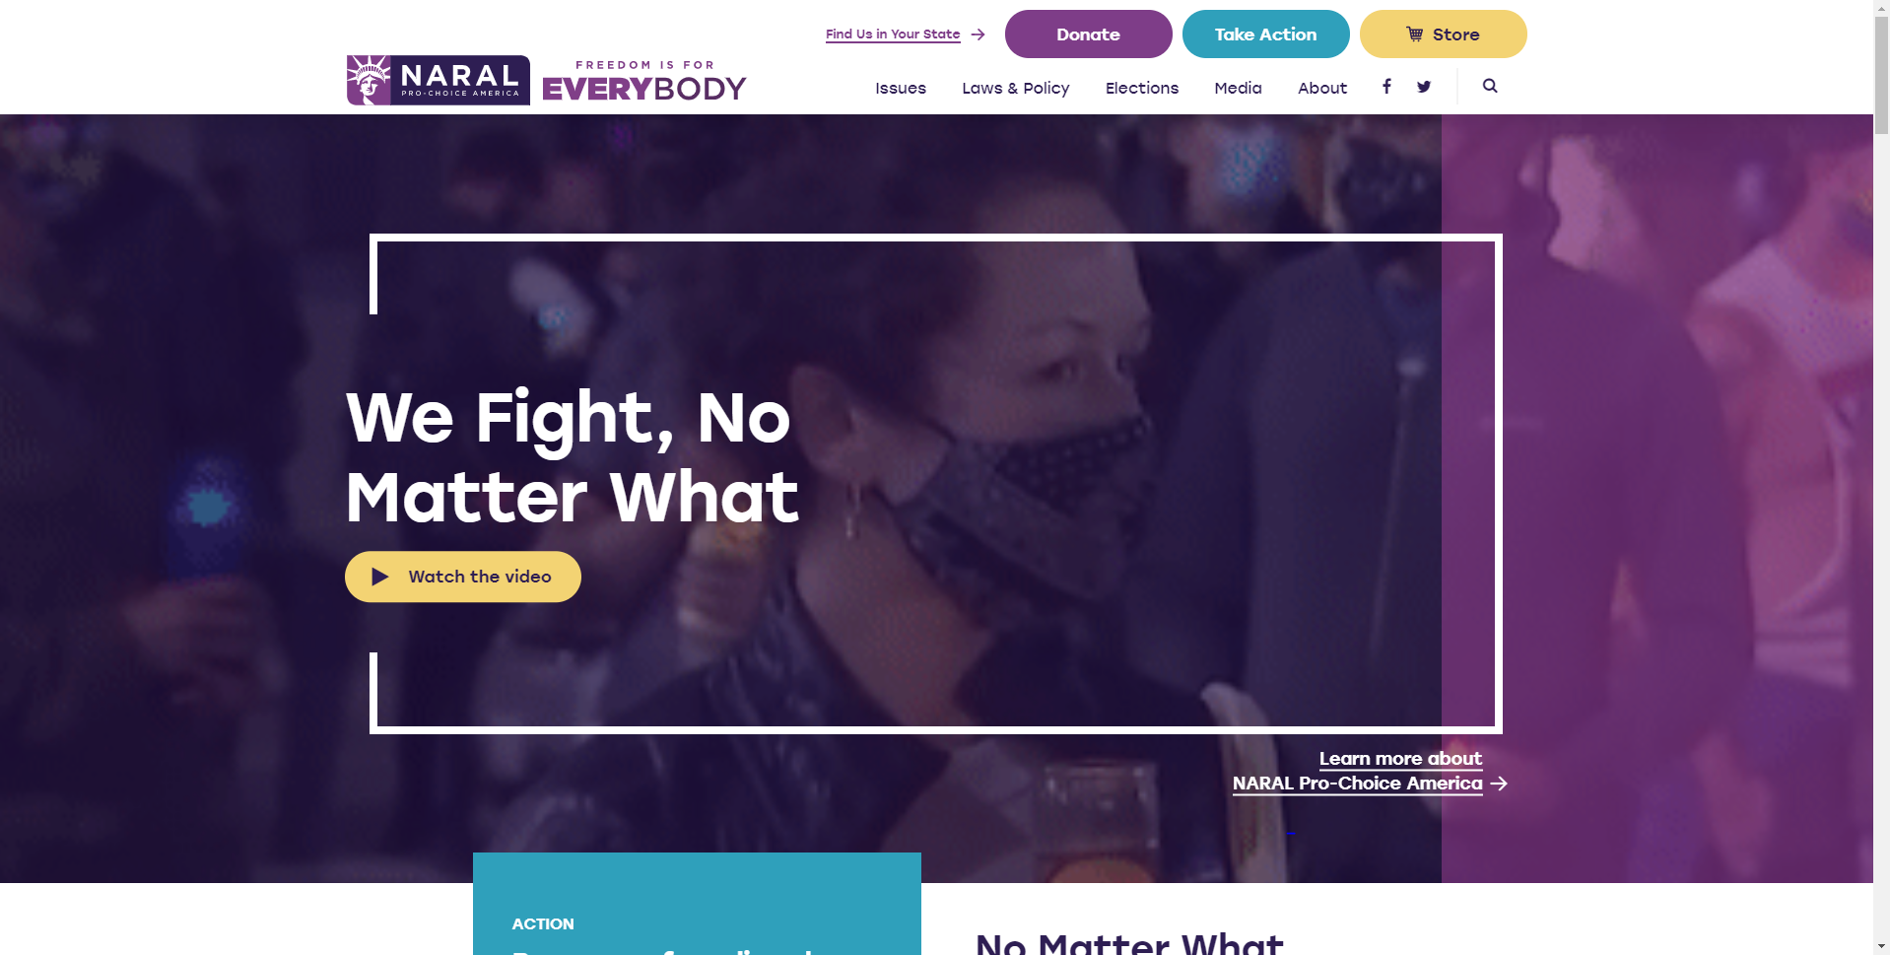
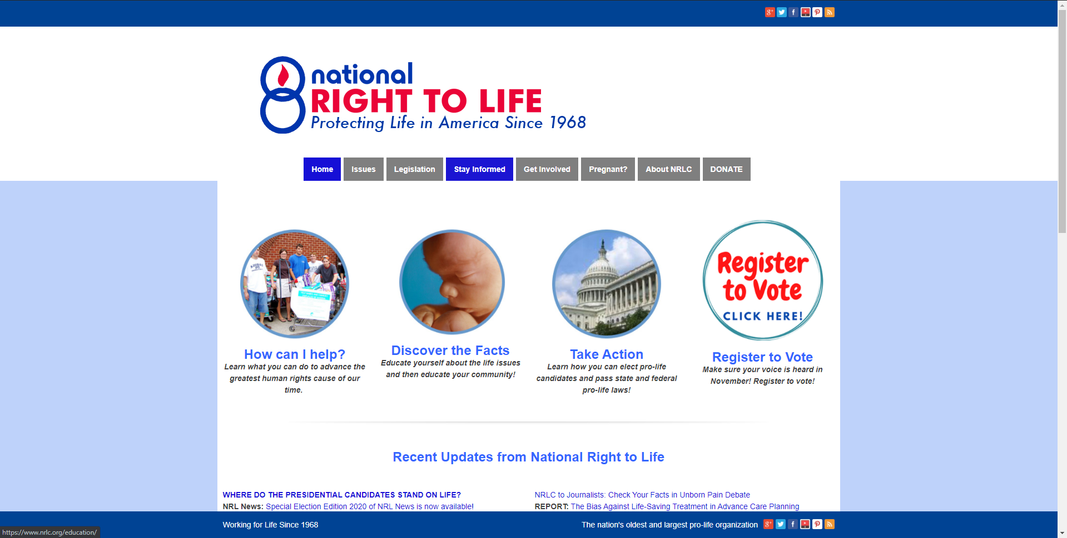
NARAL Website
Right to Life Website
The website has a video that takes up most of the page that informs people about their mission
They have their socials linked on their homepage: Facebook and Twitter
They have donation, take action, and store links
They tabs that tell people about their organization and their mission.
They have YouTube video on homepage
They have socials linked: Facebook, Twitter, and YouTube
They have donation, take action, and register to vote links
They help links for pregnant women
They have tabs that link to information about their organization and their mission

Slide 7
Website Comparison
I don’t really think the differences of the quality of information differ too much to the point where one is superior.
The differences and similarities do matter because they are both fighting on the issue of abortion and basically competing against each other.

Slide 8
Equality Interest
I chosen to belong to equality interest that support equality for all people in America. I chose this because of views on racial discrimination and the fact that I am an African American in America. I don’t yet see equality for Americans as of now and I want to support groups that help protect equality interest.

Slide 9
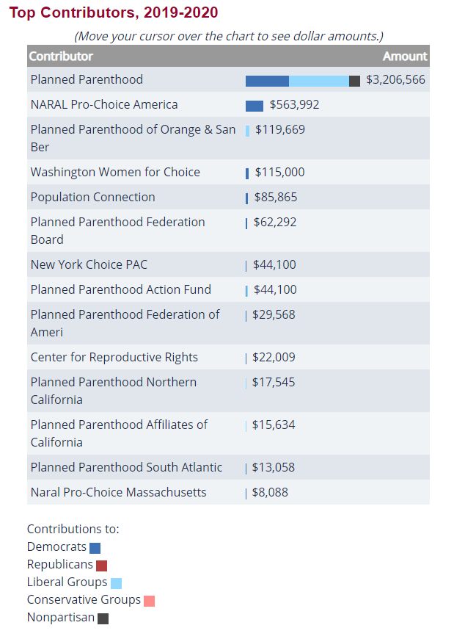
NARAL Funding
45% of funding from individuals, 19% from PACs, and 36% from Soft money
100% of funding goes to the Democratic party and democratic candidates

Slide 10
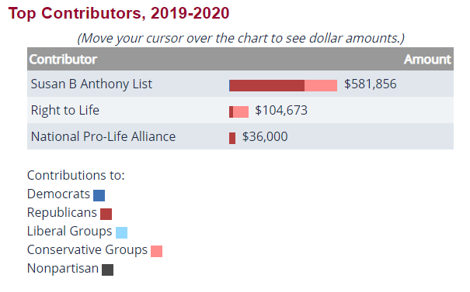
Right to Life Funding
41% of funding from individuals, 9% from PACs, and 49% from Soft money
$24,858 of funding goes to the Republican party and republican candidates and $79,815 goes to conservative groups

Slide 11
NARAL Legislation
The Trust Nevada Women Act gets rid of the requirement for doctors to tell pregnant patients about the “emotional implications” of abortion and removes the criminal penalties for inducing abortion without the advice of doctor passed in 2019.

Slide 12
Right to Life Legislation
Pain-Capable Unborn Child Protection Act makes it illegal to perform an abortion after the fetus is 20 weeks old passed in 2017.

Slide 13
Works Cited Links
https://www.congress.gov/bill/115th-congress/house-bill/36
https://www.vox.com/2019/5/22/18635687/trust-nevada-women-act-abortion-laws-2019
https://www.nrlc.org/
https://www.opensecrets.org/industries/
https://justfacts.votesmart.org/interest-groups
https://www.prochoiceamerica.org/

